Slide 1

Exploratory Data Analysis
Bank-Marketing-Campaign
June 16, 2023

Slide 2
Group Name: Team Winning Mode
Team Members:
1. Pooja Honneshwari Ravi
- poojaravi385@gmail.com, USA,
California State University-Fullerton, Data Science
2. Guru Guha Narayanan Muthunarayanan
- nguruguha@gmail.com, UK,
University of Manchester, Data Science
3. Joyeta Saha
- mim.joye@gmail.com, UK,
University of Surrey, Data Science
4. Darshan Patil
- darshan.patil1128@gmail.com, USA,
Rutgers University, Data Science

Slide 3

GitHub Link
https://github.com/poojaravi05/Bank-Marketing-Campaign-

Slide 4
Agenda
Problem Statement
Approach
EDA
EDA Summary
Recommendations
Proposed Models

Slide 5
Problem Statement
ABC Bank is planning to launch a new term deposit product and wants to identify potential customers who are more likely to purchase the product.
They aim to develop a machine learning (ML) model based on customers' past interactions with the bank or other financial institutions.
The purpose of this model is to assist in shortlisting customers with a higher probability of buying the term deposit, allowing the bank's marketing channels to focus their efforts and resources on those customers.
By targeting the right customers, ABC Bank aims to optimize its marketing campaigns and save valuable resources and time.

Slide 6
Approach
Importing the necessary libraries and the dataset
Checking for missing/null values, duplicate values, and outliers
Cleaning the data by treating/removing the null/duplicates/outliers present in the dataset
Performing Exploratory Data Analysis on the cleaned data
Few visualizations were added to better assess the data and to draw recommendations from them
Modelling the data
Getting to a conclusion.

Slide 7
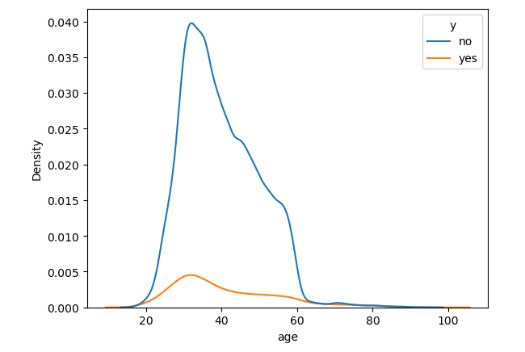
Exploratory Data Analysis

Slide 8
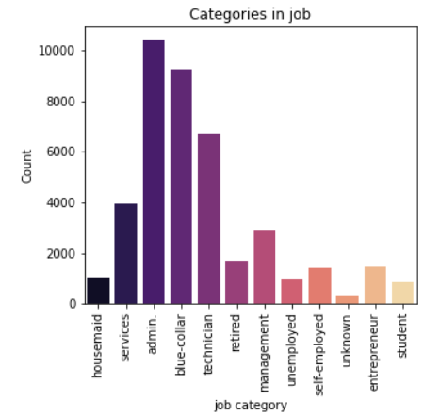
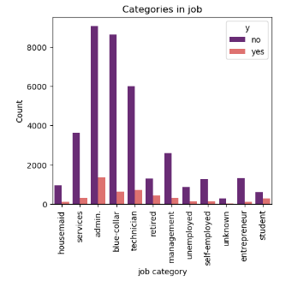
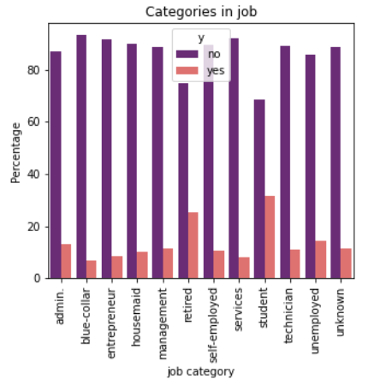
Analysis of Job Category
Most people who were contacted had an admin or a blue-collar job.
Students were the least contacted. This may however be due to a lesser number of students .
However, the campaign tends to have a higher success rate among students and the least success among those with blue-collar jobs.

Slide 9
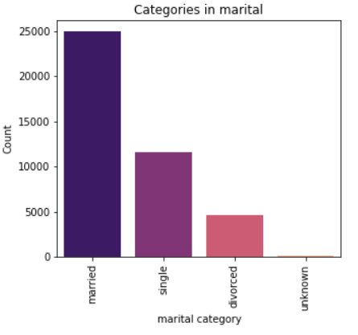
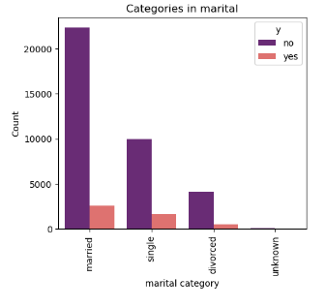
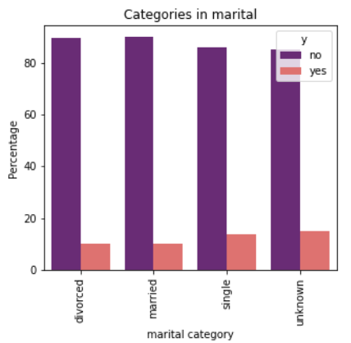
Analysis of Marital Category
Most people contacted were married.
The marital status however does not seem to play a role in whether they buy the term deposit product or not.

Slide 10
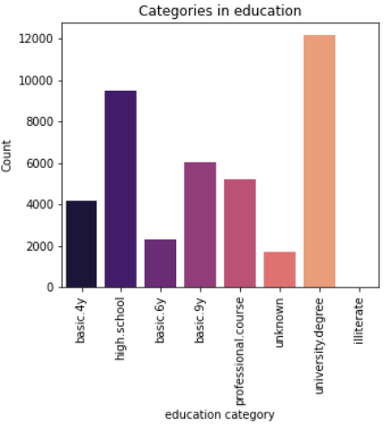
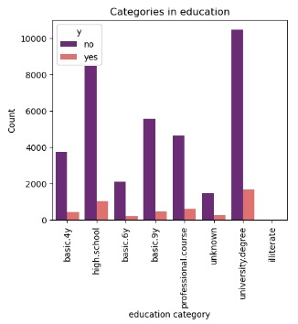
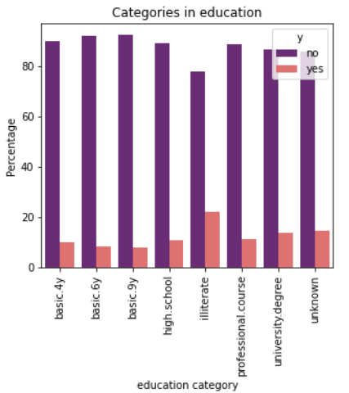
Analysis of Education Category
Most customers contacted were university degree holders.
About 20% of the illiterate customers that were contacted decided to buy the product, which is the highest among all education levels even though they were the least contacted(18).

Slide 11
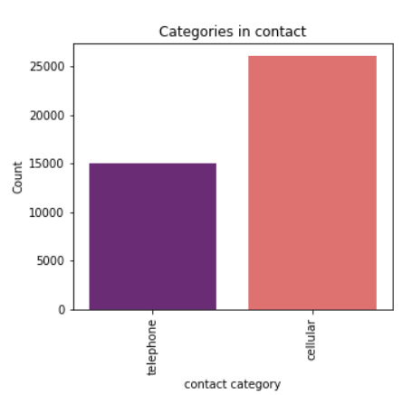
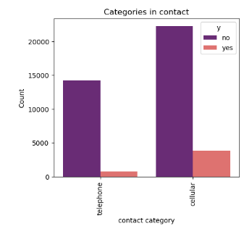
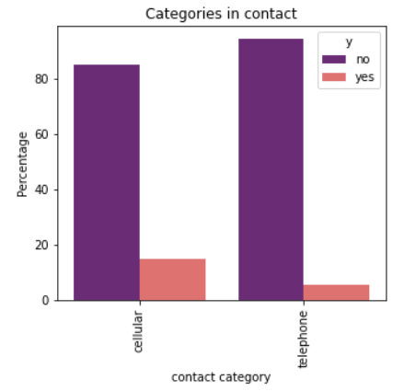
Analysis of Contact Category
Most people were contacted via mobile. Those contacted by mobile are more likely to buy the product than those who were contacted through telephone.

Slide 12
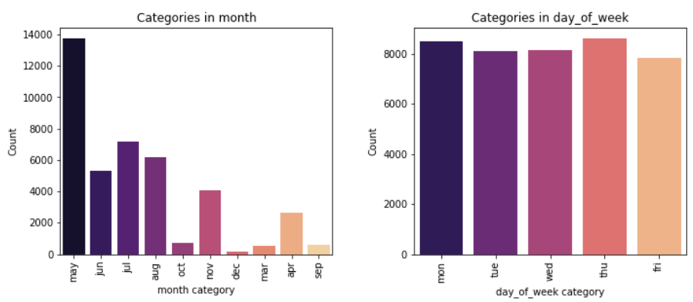
Analysis of Month & Day of Week Categories

Slide 13
Findings and Recommendations
Try to target more students as they seem to be more likely to buy the product.
Increase the reach of the campaign to those who are illiterate.

Slide 14
Proposed Models
Being a binary classification problem, the initial model we propose is a logistic regression model to find the probability that a customer either bought or did not buy the product.
Next, we propose decision trees and random forest classifiers.
Finally, we propose an SVM

Slide 15
Thank You

